Slide 1
Interrupts
Mechanism by which other modules (e.g. I/O) may interrupt normal sequence of processing of a CPU
Provided as a way to improve processing efficiency
The most common classes of interrupts are:
Program
  e.g. overflow, division by zero
Timer
  Generated by internal processor timer, allows the OS to perform certain functions on a regular basis
  Used in pre-emptive multi-tasking
I/O
  Generated by I/O controller, to signal normal completion of an operation or to signal a variety of error conditions
Hardware failure
  Generated by a failure, e.g. memory parity error, power failure

Slide 2
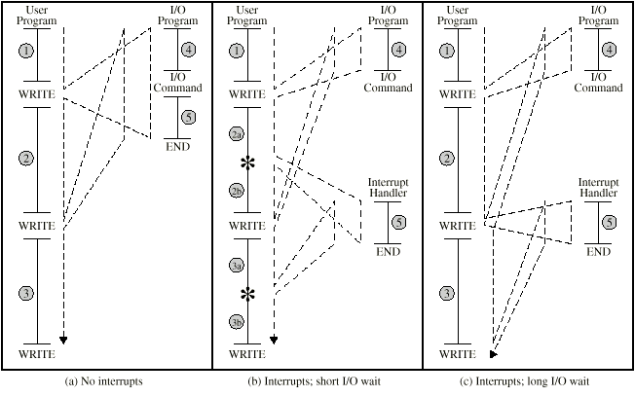
Program Flow Control

Slide 3
If no interrupt is there (figure a):
The write calls go to system utility i.e. I/O program to perform the actual I/O operation in three sections
  Labeled 4 instructions: To prepare for the actual I/O operation. This may include copying the data into a buffer, and preparing parameters for device command.
  The actual I/O command. Once this command is issued, the program must wait for the I/O device to perform the requested function. The program waits until the I/O operation is done.
  Labeled 5 instructions: To complete the operation. This may include setting a flag indicating the success or failure of operation.

Slide 4
With Interrupts (figure b):
The processor can be engaged in executing other instructions while an I/O operation is in progress.
As before after the write call the I/O program is invoked and preparation code (labeled 4) and actual I/O command is executed; then control returns to the user program.
The external device is busy accepting data from memory and printing it.
When the external device is ready to accept more data from the processor, the I/O module send an interrupt request signal to the processor.
The processor responds by suspending operation of the current program, branching off to a program to service that particular I/O device, called interrupt handler, and resumes the original execution after the device is serviced.

Slide 5

Transfer of Control via Interrupts

Slide 6
Interrupt Cycle
To accommodate interrupts, an interrupt cycle is added to instruction cycle
Processor checks for interrupt
  Indicated by an interrupt signal
If no interrupt, fetch next instruction
If interrupt pending:
  Suspend execution of current program
  Save context( current content of PC and other data relevant to the processors current activity)
  Set PC to start address of interrupt handler routine (Normally part of OS)
  Process interrupt
  Restore context and continue interrupted program

Slide 7

Instruction Cycle with Interrupts

Slide 8
Efficiency
Interrupt process involve some overhead to determine the nature of interrupt and to decide appropriate action.
This overhead is relatively less wasteful than simply waiting an I/O operation.
Processor can be employed much more efficiently with the use of interrupt.

Slide 9
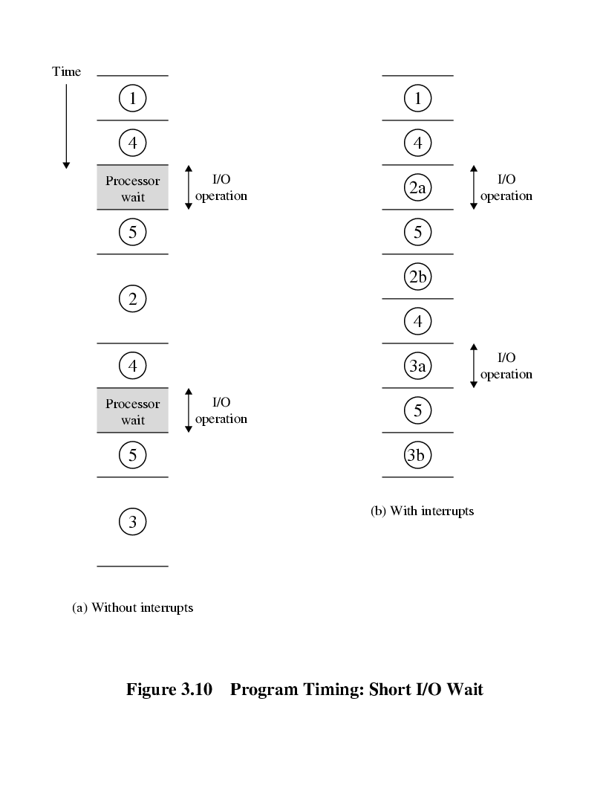
Program Timing
Short I/O Wait

Slide 10
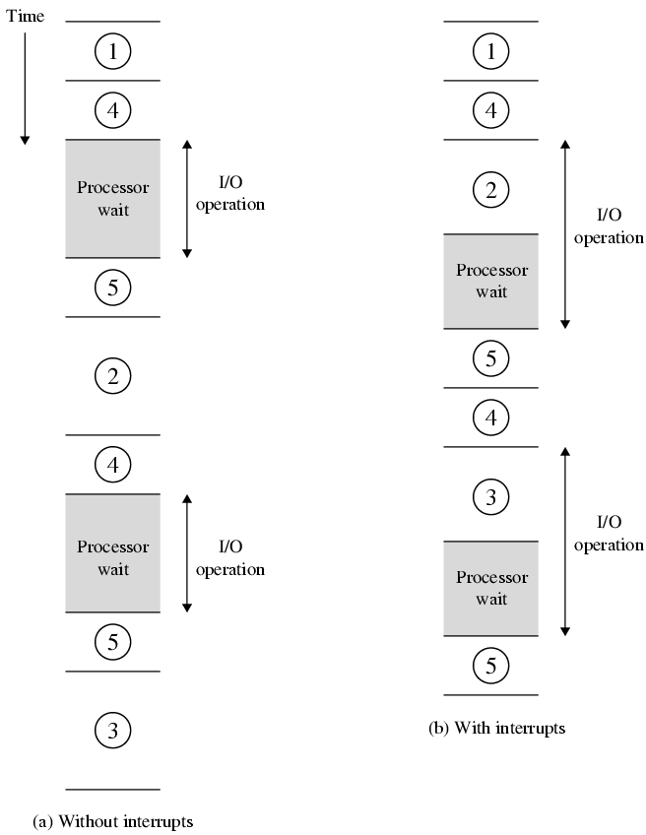
Program Timing
Long I/O Wait

Slide 11
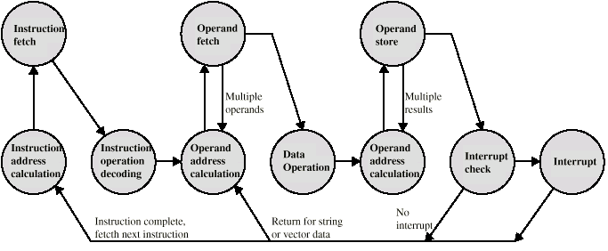
Instruction Cycle (with Interrupts) - State Diagram

Slide 12
Multiple Interrupts
Example:
  Program may be receiving data and printing results. The printer interrupts as it completes a print operation. The modem/NIC generates interrupts every time a unit of data arrives.
Two approaches can be taken:
Disable interrupts
  Processor will ignore further interrupts whilst processing one interrupt
  Interrupts remain pending and are checked after first interrupt has been processed
  Interrupts handled in sequence as they occur
Define priorities
  Low priority interrupts can be interrupted by higher priority interrupts
  When higher priority interrupt has been processed, processor returns to previous interrupt

Slide 13

Multiple Interrupts - Sequential
Disadvantage: does not take into account relative priority or time-critical needs

Slide 14
Multiple Interrupts – Nested

Slide 15

Time Sequence of Multiple Interrupts

Slide 16
Connecting
All the units (processors, memory, I/O) must be connected
Computer is a network of basic modules.
Different type of connection for different type of unit
  Memory
  Input/Output
  CPU

Slide 17

Computer Modules

Slide 18
Memory Connection
Receives and sends data
Receives addresses (of locations)
Receives control signals
  Read
  Write
  Timing

Slide 19
Input/Output Connection(1)
Similar to memory from computer’s viewpoint
Output
  Receive data from computer
  Send data to peripheral
Input
  Receive data from peripheral
  Send data to computer

Slide 20
Input/Output Connection(2)
Receive control signals from computer
Send control signals to peripherals
  e.g. spin disk
Receive addresses from computer
  e.g. port number to identify peripheral
Send interrupt signals (control)

Slide 21
CPU Connection
Reads instruction and data
Writes out data (after processing)
Sends control signals to other units
Receives (& acts on) interrupts

